Slide 1
Encryption of Sampled Value Protocol in
Substations Using One-Time Pads
By: Tolulope Olugbenga, Ashraf Ali, Kwasi Boakye-Boateng, Mohammadreza MontazeriShatoori

Slide 2
Outline
Introduction
Problem
Proposed Algorithm
Implementation
Results
Conclusion & Future Work
2

Slide 3
Substation Automation System
It is essential in economically maintaining the energy balance between generation and demand in the operation of electrical power
The most important functions of a SAS are:
Control
Monitoring
Alarming
Measurement
3

Slide 4
Substation Automation System
An SAS is based on a lot of dedicated software stored in pieces of hardware that belong to a set of substation secondary components.
An SAS is comprised of three levels of devices plus two Local Area Networks integrated:
Process
Bay
Station
4

Slide 5
Substation Automation System
The process level devices:
analog/digital converters (Merging Units) and actuator devices to make the transition between SAS and high voltage equipment.
The bay level devices:
a set of Intelligent Electronic Devices (IEDs) that receive and process signals coming from high voltage equipment.
The station level devices:
all computers and other components required to run control functionalities and to communicate with internal and external subsystems (eg. SCADA and HMI).
5

Slide 6
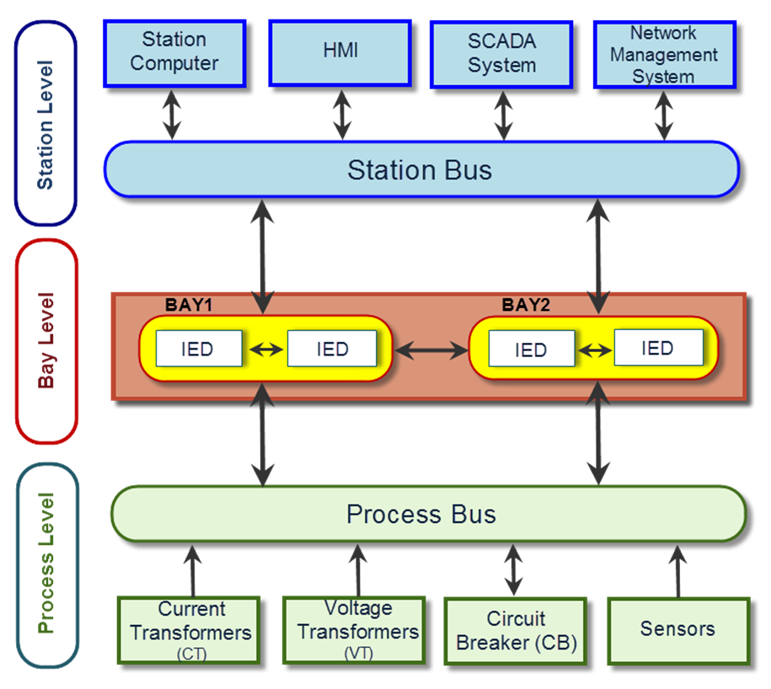
SAS Architecture
6

Slide 7
International Electrotechnical Commission (IEC) 61850
A standard for communication and information exchange with the substation
Ethernet-based (IEEE 802.3 standard) communication
Ensures vendor interoperability among devices
Abstracts data and services making them independent of any underlying protocol.
Protocol must be well-mapped to IEC 61850 data objects and services to be implemented.
Theoretically a protocol could be created specifically for IEC61850 albeit complex
7

Slide 8
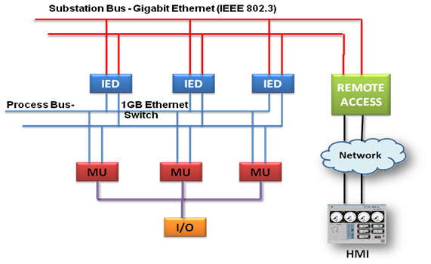
IEC 61850 SAS Implementation
8

Slide 9
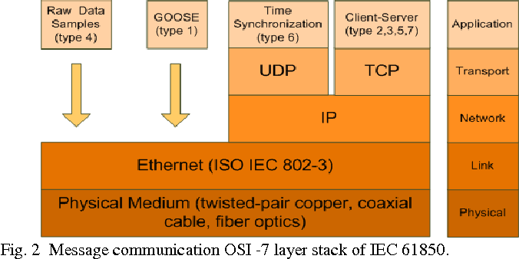
IEC 61850 OSI Architecture
9

Slide 10
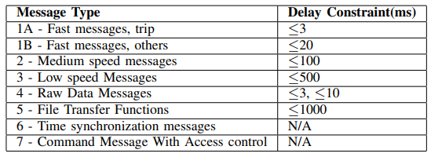
IEC 61850 Performance Requirements
10

Slide 11
Sampled Measured Values (SMV or SV)
Used for communication between IEDs
Reliable, fast and real-time (Type 4)
SV messages embed numerical samples of current and voltage signals
Uses publish-subscribe model of communication
11

Slide 12
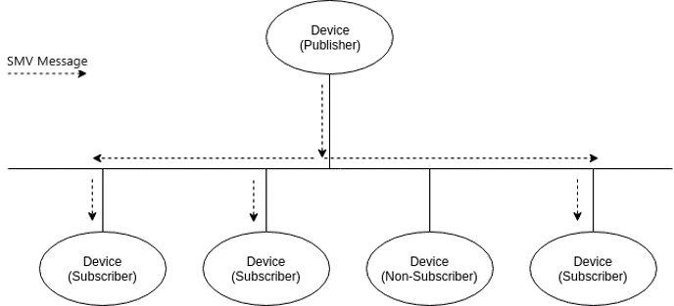
Publish-Subscribe Model
Comprises an IED (the publisher) creates a message that is delivered to a group of destination IEDs (the subscribers) simultaneously in a single transmission from the source.
Multicast messages
Repetition strategy against packet loss
Unconfirmed communication
Event driven timing
ASN.1 encoded payload
12

Slide 13
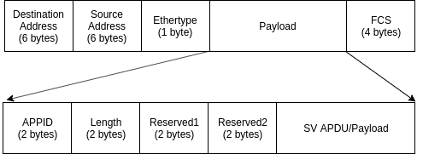
SV Packet Structure
13

Slide 14
SV Packet Structure
The SV datagram has twelve fields that define the Protocol Data Unit (PDU)
destination (multicast) address and source address are Ethernet MAC addresses (recommended format 01-0C-CD-04-YY-YY)
Ethertype of a SV message is 88-BA.
Application ID and length (m + 8 bytes).
The Reserved1 and Reserved2 fields (set to 0, reserved for future use)
Application PDU (APDU) and Field Control Sequence (FCS).
14

Slide 15
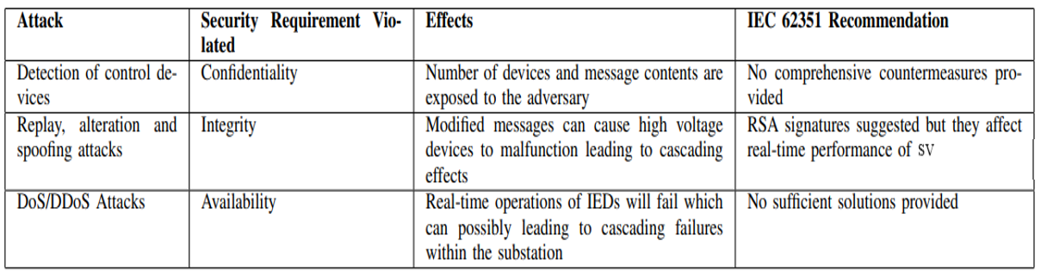
Problem – Attack Taxonomy Relating To SV
15

Slide 16
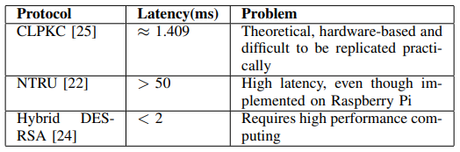
Problem – Existing Research Securing SV
16

Slide 17
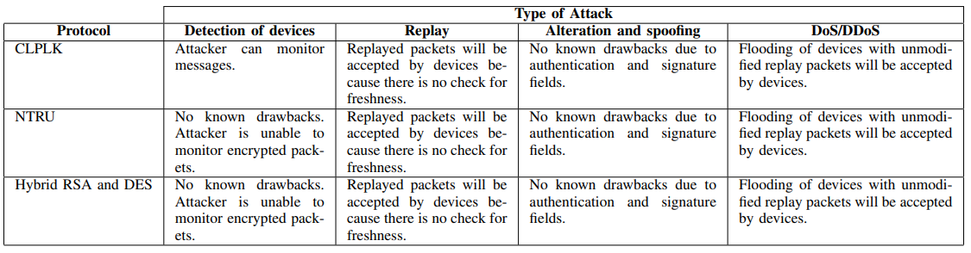
Problem – Existing Research Securing SV
17

Slide 18
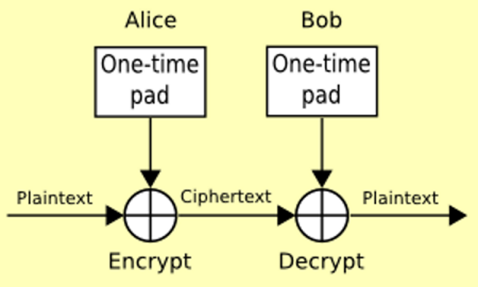
Motivation
Encrypt SV Packets with One-Time Pads (OTP)
OTP encryption involves a modulo addition between the key and the plaintext
The key is used once, hence the name One-Time Pad
OTP has same length as plaintext
18

Slide 19
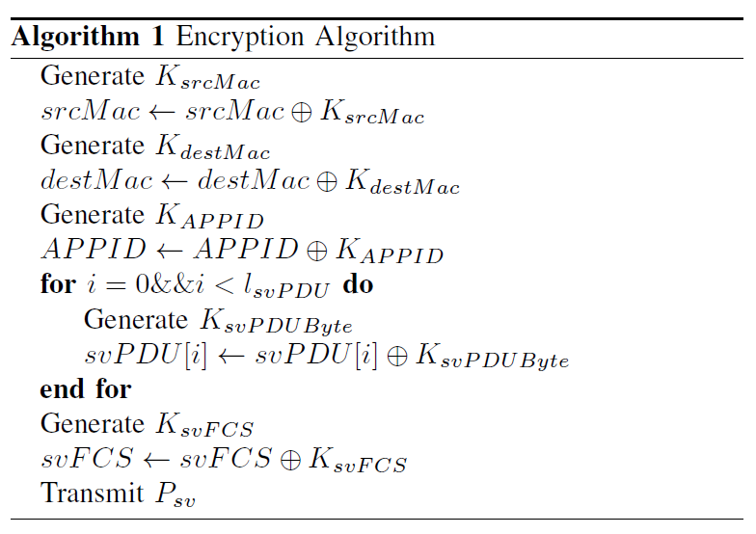
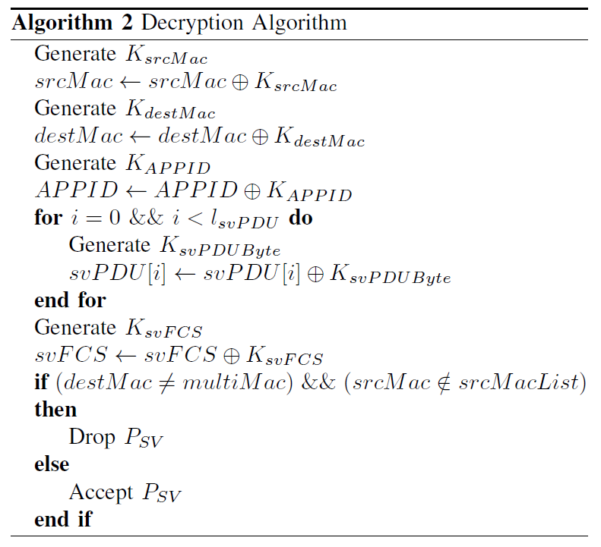
Proposed Algorithms
19

Slide 20
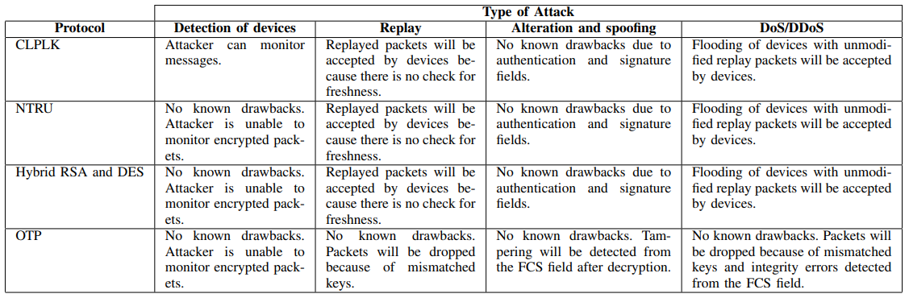
Predicted Results – Comparisions Against Attack Taxonomy
20

Slide 21
Conclusion
Encryption/Decryption of SV packets using OTP is possible
A better environment is required to properly measure its efficiency
Key Generation, Key Exchange and Refreshment regarded as future work
Effectiveness against network congestion also regarded as future work
21

Slide 22
References
B. Schneier, Applied Cryptography: Protocols, Algorithms, and Source Code in C. New York: Wiley, 1996.
J. Hoyos, M. Dehus, and T. X. Brown, “Exploiting the GOOSE protocol: A practical attack on cyber-infrastructure,” in 2012 IEEE Globecom Workshops. IEEE, dec 2012, pp. 1508–1513.[Online]. Available:http://ieeexplore.ieee.org/document/6477809/
W. Fangfang, W. Huazhong, C. Dongqing, and P. Yong, “Substation Communication Security Research Based on Hybrid Encryption of DES and RSA,” in 2013 Ninth International Conference on Intelligent Information Hiding and Multimedia Signal Processing. IEEE, oct 2013, pp. 437–441. [Online]. Available: http://ieeexplore.ieee.org/document/6846671/
J. ZHANG, L. Jun’e, C. Xiong, N. Ming, W. Ting, and L. Jianbo, “A security scheme for intelligent substation communications considering real-time performance,” Journal of Modern Power Systems and Clean Energy, pp. 1–14, 2019.
A. P. Premnath, J.-Y. Jo, and Y. Kim, “Application of NTRU Cryptographic Algorithm for SCADA Security,” in 2014. 11th International Conference on Information Technology: New Generations. IEEE, apr 2014, pp. 341–346. [Online]. Available: http://ieeexplore.ieee.org/document/6822221/
“Scapy.” [Online]. Available: https://scapy.net/
22

Slide 23
Thank you

